Slide 1
AligneR: A Process-in-Memory Architecture for Short Read Alignment in ReRAMs
F. Zokaee, H. R. Zarandi and L. Jiang
IEEE Computer Architecture Letters 2018

Slide 2
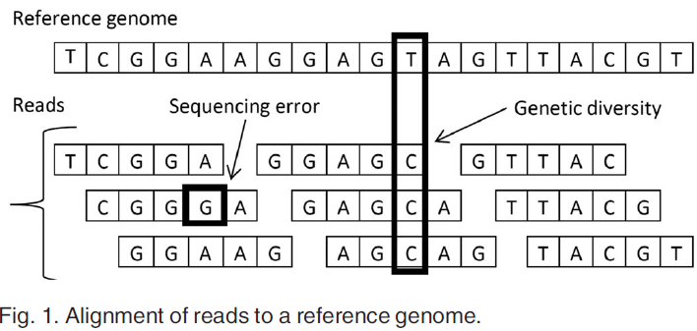
Short Read Alignment
Build Index!

Slide 3
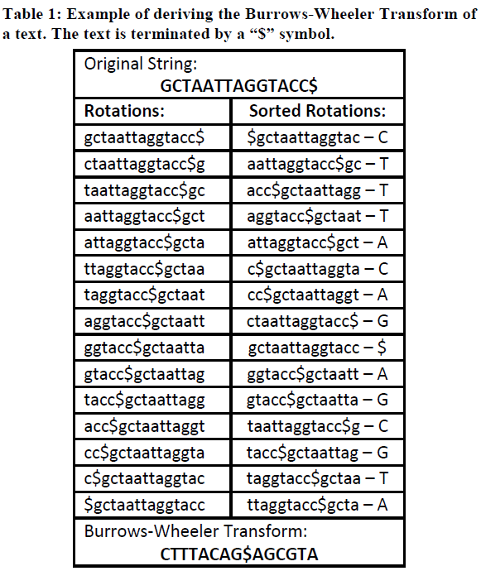
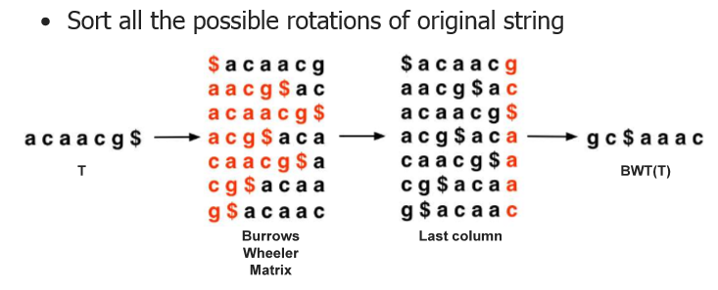
Burrows-Wheeler Transform (BWT)
The Index stores BWT(last column)

Slide 4
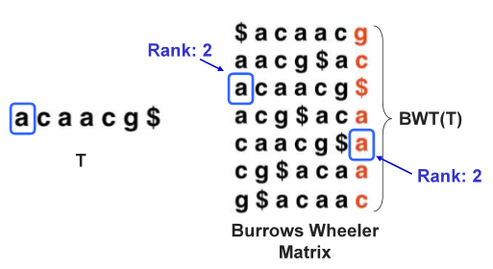
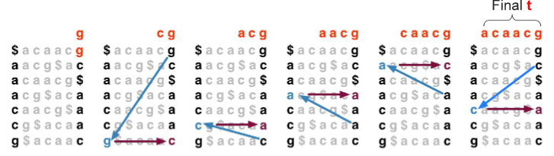
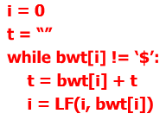
Properties
Same ranking of character in the L (BWT) and F
Reversible (Walk-Left algorithm)：backward 1by1
In a row，L is the previous character of F，Blue arrow: L-F mapping

Slide 5
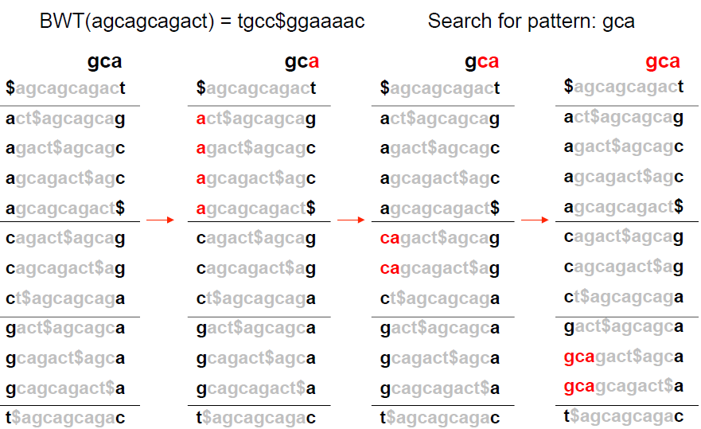
Exact Matching
Property: L is the previous char of F

Slide 6
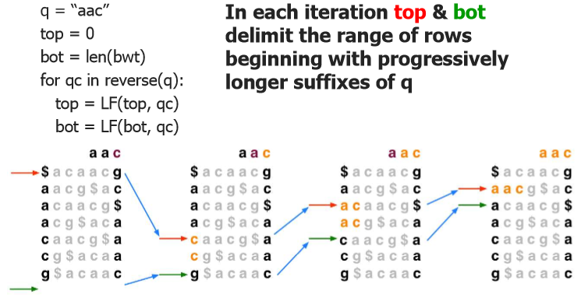
Exact Matching
Property: L is the previous char of F
-1
LF Mapping
LF Mapping
LF Mapping
top
top
top
bot
top
bot
bot
bot

Slide 7
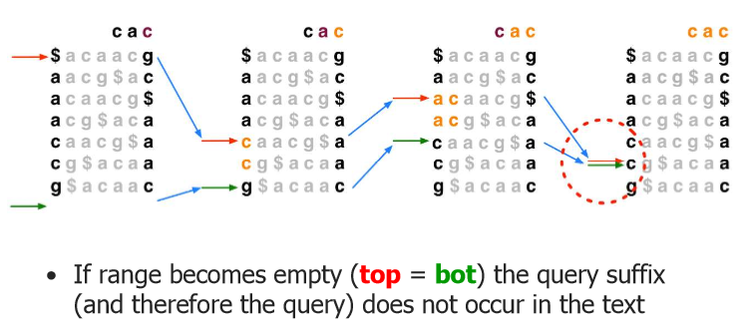
Exact Matching
Property: L is the previous char of F
Cannot find C in previous position, fail to align. After the LF mapping, top>=bot
LF Mapping
LF Mapping
LF Mapping

Slide 8
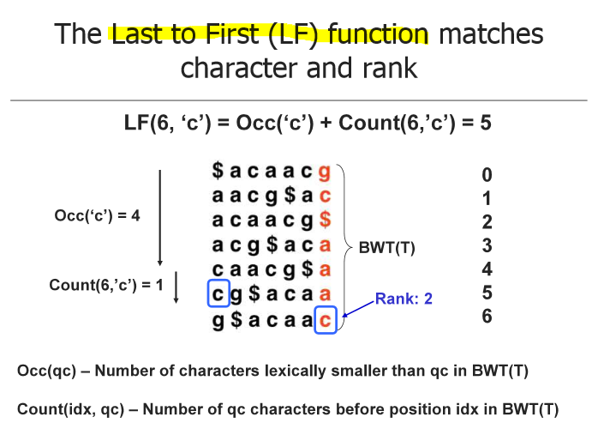
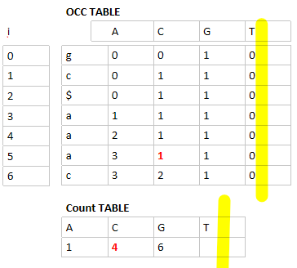
Last to First mapping (LF mapping)
According to the position of L (idx) , find the aligning char (qc) in F (next position)
Property: Same ranking of character in the L (BWT) and F
Count
Occ
Count
Occ
Count: 统计有多少个比当前比对字符小的字符
Occ: 统计之前有多少已经出现多少个当前比对的字符
Count
Occ
idx=6，qc=c

Slide 9
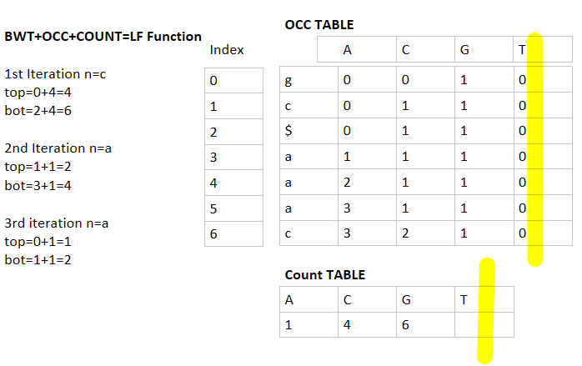
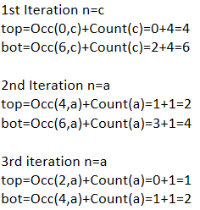
Exact Matching (LF mapping)
Initialization: top=0, bot=len(BWT)-1
From top，find char qc in F, it must be the position of the first qc
Similarly, from bot, the position of the last qc.
-1
LF Mapping
LF Mapping
LF Mapping
top
top
top
bot
top
bot
bot
bot

Slide 10
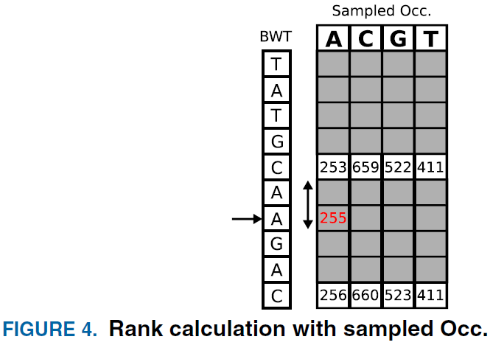
Store Occ and Count to compute and align
Occ: too big, store samples (d=5)
How many A in previous？ (Suppose qc=A)
Reverse to sample，get 253，find one A during reverse，so 253+1=254
count=1, not Count-table
Add Count to the sample，get marker. Marker is the new sample.
Store markers rather than Occ
Marker=Sampled Occ+Count
Next position: Marker(>253)+count(=1)
Finish one LF mapping (iteration)
Position: 255+659+522+411

Slide 11
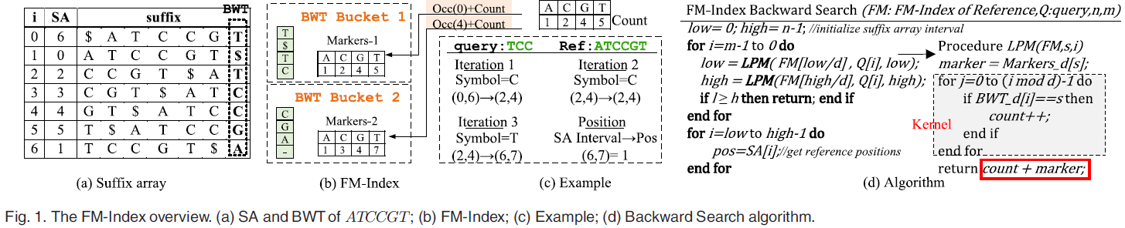
Overview
A C G T
Marker-1: 0 0 0 0+1 2 4 5=1 2 4 5
Marker-2: 0 1 0 2+1 2 4 5=1 3 4 7
Sampled Occ+Count=marker
backward
Position/d，which bucket/marker
d=4
(top,bot)
Fail to align (low/bot>=high/top)
j=0; 01; 012; 0123
Find positions of all successful alignments
LFM kernel: counting the occurrence of the symbol s (count)
Worst case: count 2*m*d times

Slide 12
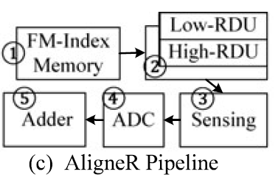
AligneR
Accelerate the kernel by converting the symbol counting problem to the Hamming Distance calculation
ReRAM based Hamming Distance Unit (RDU)
Step 1: Fetch the BWT section (d symbols, <=4)
Step 2: d BWT symbols and d copies of symbol s (aligning symbol) are passed to RDU
Step 3: The summed current is held by a sense & hold circuit
Step 4: The current is converted to a digital value hd (count=d-hd)
Step 5: Sum count and marker: (d-hd+marker)

Slide 13
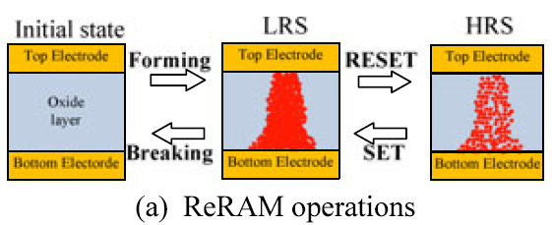
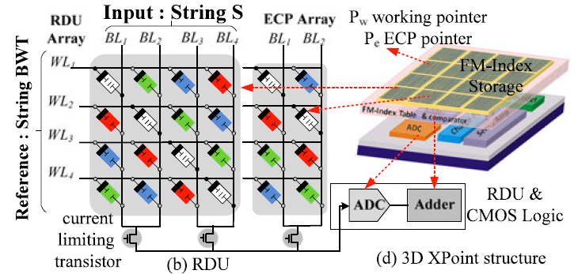
ReRAM based Hamming Distance Unit (RDU)
Initialization: Only 4 diagonal cells (white/blue/green/red) are actually used to calculate the HD.
Others: not formed
All 4 selected cells are initialized to HRS
Encode A, C, G, T by 00, 01, 10, 11
0V/1.5V
eg. d=2 → 4*4 ReRAM
Assume S=C, BL:0101 (CC), WL: 0000 (AA). Voltage difference → LRS
Apply a read voltage, the summed current representing the HD between CC and AA.
hd=2, count=d-hd=2-2=0, no C
6. Adder: marker+count

Slide 14
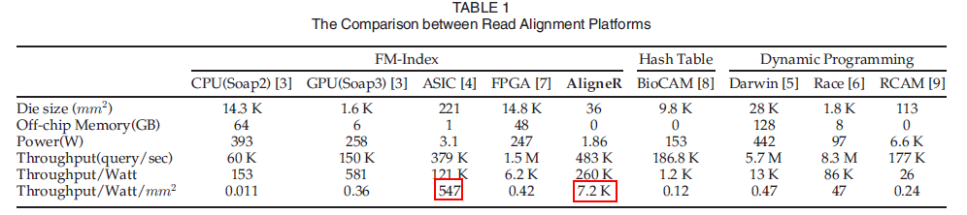
Results and Discussion

